Slide 1

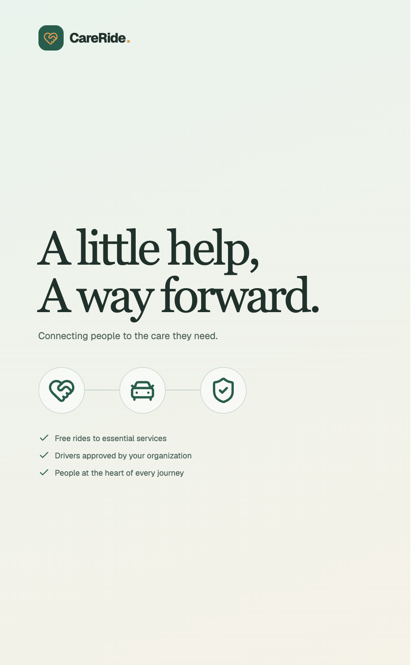
CareRide.
TEAM 2 · HACKVAN2026
CARERIDE / TEAM 2 / HACKVAN2026
A little help,
A way forward.
Connecting people to the care they need.
A community transportation proposal
for people experiencing homelessness
and other vulnerable neighbours.
01 / 10
Notes:
30 seconds.
Imagine having an appointment that could change your week, but no reliable way to get there. For someone experiencing homelessness, the distance to care can be much greater than the distance on a map. We are Team 2, and this is CareRide: a little help, a way forward. We connect the people arranging care with the people willing to offer a ride, so more neighbours can reach the services they need.
Sources: CareRide Team 2 HACKVAN2026.pdf, pp. 19–21; docs/CARERIDE_REQUIREMENTS.md; current app source. Host: https://luma.com/faithtech-hack2026. Partnership and pilot are proposals. Screenshots contain synthetic demo data.

Slide 2
CareRide.
TEAM 2 · HACKVAN2026
THE HUMAN NEED
Care exists.
Getting there is the gap.
01
02
03
A place to go
A barrier to cross
A person to help
Hospitals, shelters, and essential services.
No smartphone, limited digital access, or no reliable ride.
Staff need a clear way to coordinate the journey.
A seat in your car can open a door to care.
Source: supplied Belkin challenge brief, PDF pp. 19–20.
02 / 10
Notes:
45 seconds.
The Belkin Communities of Hope brief describes a practical and deeply human problem. Clients need to travel to hospitals, shelters, and other essential services. Some do not have smartphones or the digital literacy to arrange a conventional ride independently. Staff step in, but requests, calls, and updates can become fragmented across organizations. That leaves two people carrying the uncertainty: the client wondering whether they will get there, and the staff member trying to arrange it. CareRide focuses on this specific access barrier for people experiencing homelessness and other vulnerable neighbours. A seat in a car can become a door to care.
Sources: CareRide Team 2 HACKVAN2026.pdf, pp. 19–21; docs/CARERIDE_REQUIREMENTS.md; current app source. Host: https://luma.com/faithtech-hack2026. Partnership and pilot are proposals. Screenshots contain synthetic demo data.

Slide 3
CareRide.
TEAM 2 · HACKVAN2026
THE PROPOSAL
Put the journey
in one shared place.
01
02
03
Staff request
Drivers respond
Everyone stays informed
Arrange a free ride on a client’s behalf.
Approved volunteers review and accept eligible rides.
Track the journey from request to completion.
A little coordination. A meaningful difference.
Source: supplied Belkin challenge brief, PDF pp. 19–20.
03 / 10
Notes:
45 seconds.
Our proposal is a staff-facing community transportation platform. Staff book a free ride for a client, an eligible driver accepts it, and the staff member can follow its progress. The client does not need a smartphone or a CareRide account in this first version. We begin with the people already providing support, rather than asking someone in a difficult situation to learn another digital system. CareRide brings requests and status updates into one place, across participating organizations. This is an independent platform shaped by the Belkin brief, with future service partnerships still to be confirmed. A little coordination can make a meaningful difference.
Sources: CareRide Team 2 HACKVAN2026.pdf, pp. 19–21; docs/CARERIDE_REQUIREMENTS.md; current app source. Host: https://luma.com/faithtech-hack2026. Partnership and pilot are proposals. Screenshots contain synthetic demo data.

Slide 4



CareRide.
TEAM 2 · HACKVAN2026
HOW IT WORKS
People at the heart
of every journey.
Staff arrange
Drivers offer
Organizations approve
Awaiting driver → Driver assigned → On the way → Completed
Every connection is another step toward care.
04 / 10
Notes:
40 seconds.
The journey has three human roles. A staff member knows the client and arranges the pickup and destination. A driver offers time and a seat. The organization approves that driver for its own rides. From there, the request moves through clear stages: awaiting a driver, driver assigned, on the way, and completed. Staff can see what needs attention instead of chasing every update. Saved pickup points and essential destinations make repeat journeys easier to arrange. If a return ride is needed, each leg is handled as a separate booking, so the staff member can see whether both directions have coverage.
Sources: CareRide Team 2 HACKVAN2026.pdf, pp. 19–21; docs/CARERIDE_REQUIREMENTS.md; current app source. Host: https://luma.com/faithtech-hack2026. Partnership and pilot are proposals. Screenshots contain synthetic demo data.

Slide 5
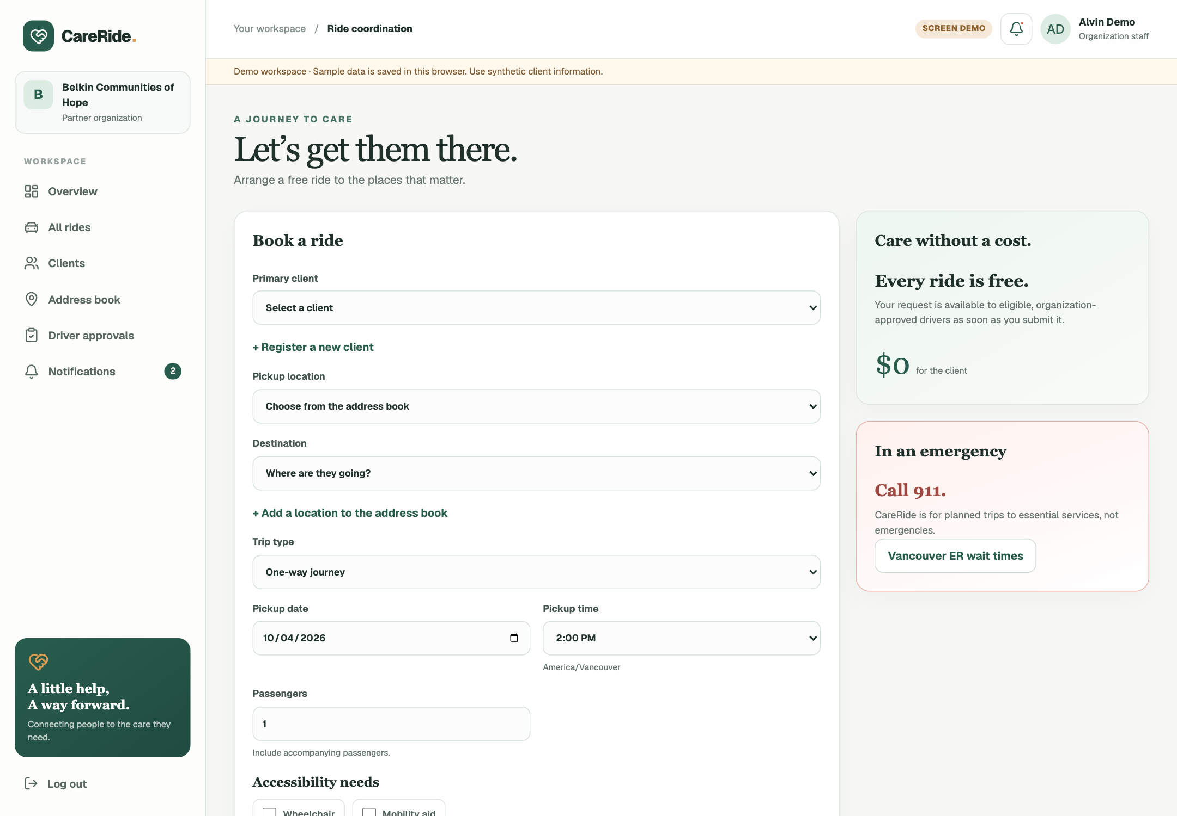
CareRide.
TEAM 2 · HACKVAN2026
THE STAFF EXPERIENCE
A ride to care
starts with you.
Select the client
Choose the journey
Request the ride
Built for the people who care for our communities.
ACTUAL PROTOTYPE · SYNTHETIC DEMO DATA
05 / 10
Notes:
60 seconds.
Here is the staff experience in the prototype. These screenshots use synthetic demo records. The dashboard puts upcoming journeys and ride status in view. The booking screen lets staff select a client, choose saved pickup and destination points, and specify when the ride is needed. That matters because staff are arranging a real commitment, often around an appointment. For a live demonstration, I would open Book a ride, choose a sample client and a saved destination, and submit the request. It then becomes a journey that an eligible driver can review. The design is deliberately calm: clear labels, familiar actions, and a layout that works on mobile. We want staff spending their attention on people, with the app helping them coordinate.
Sources: CareRide Team 2 HACKVAN2026.pdf, pp. 19–21; docs/CARERIDE_REQUIREMENTS.md; current app source. Host: https://luma.com/faithtech-hack2026. Partnership and pilot are proposals. Screenshots contain synthetic demo data.

Slide 6
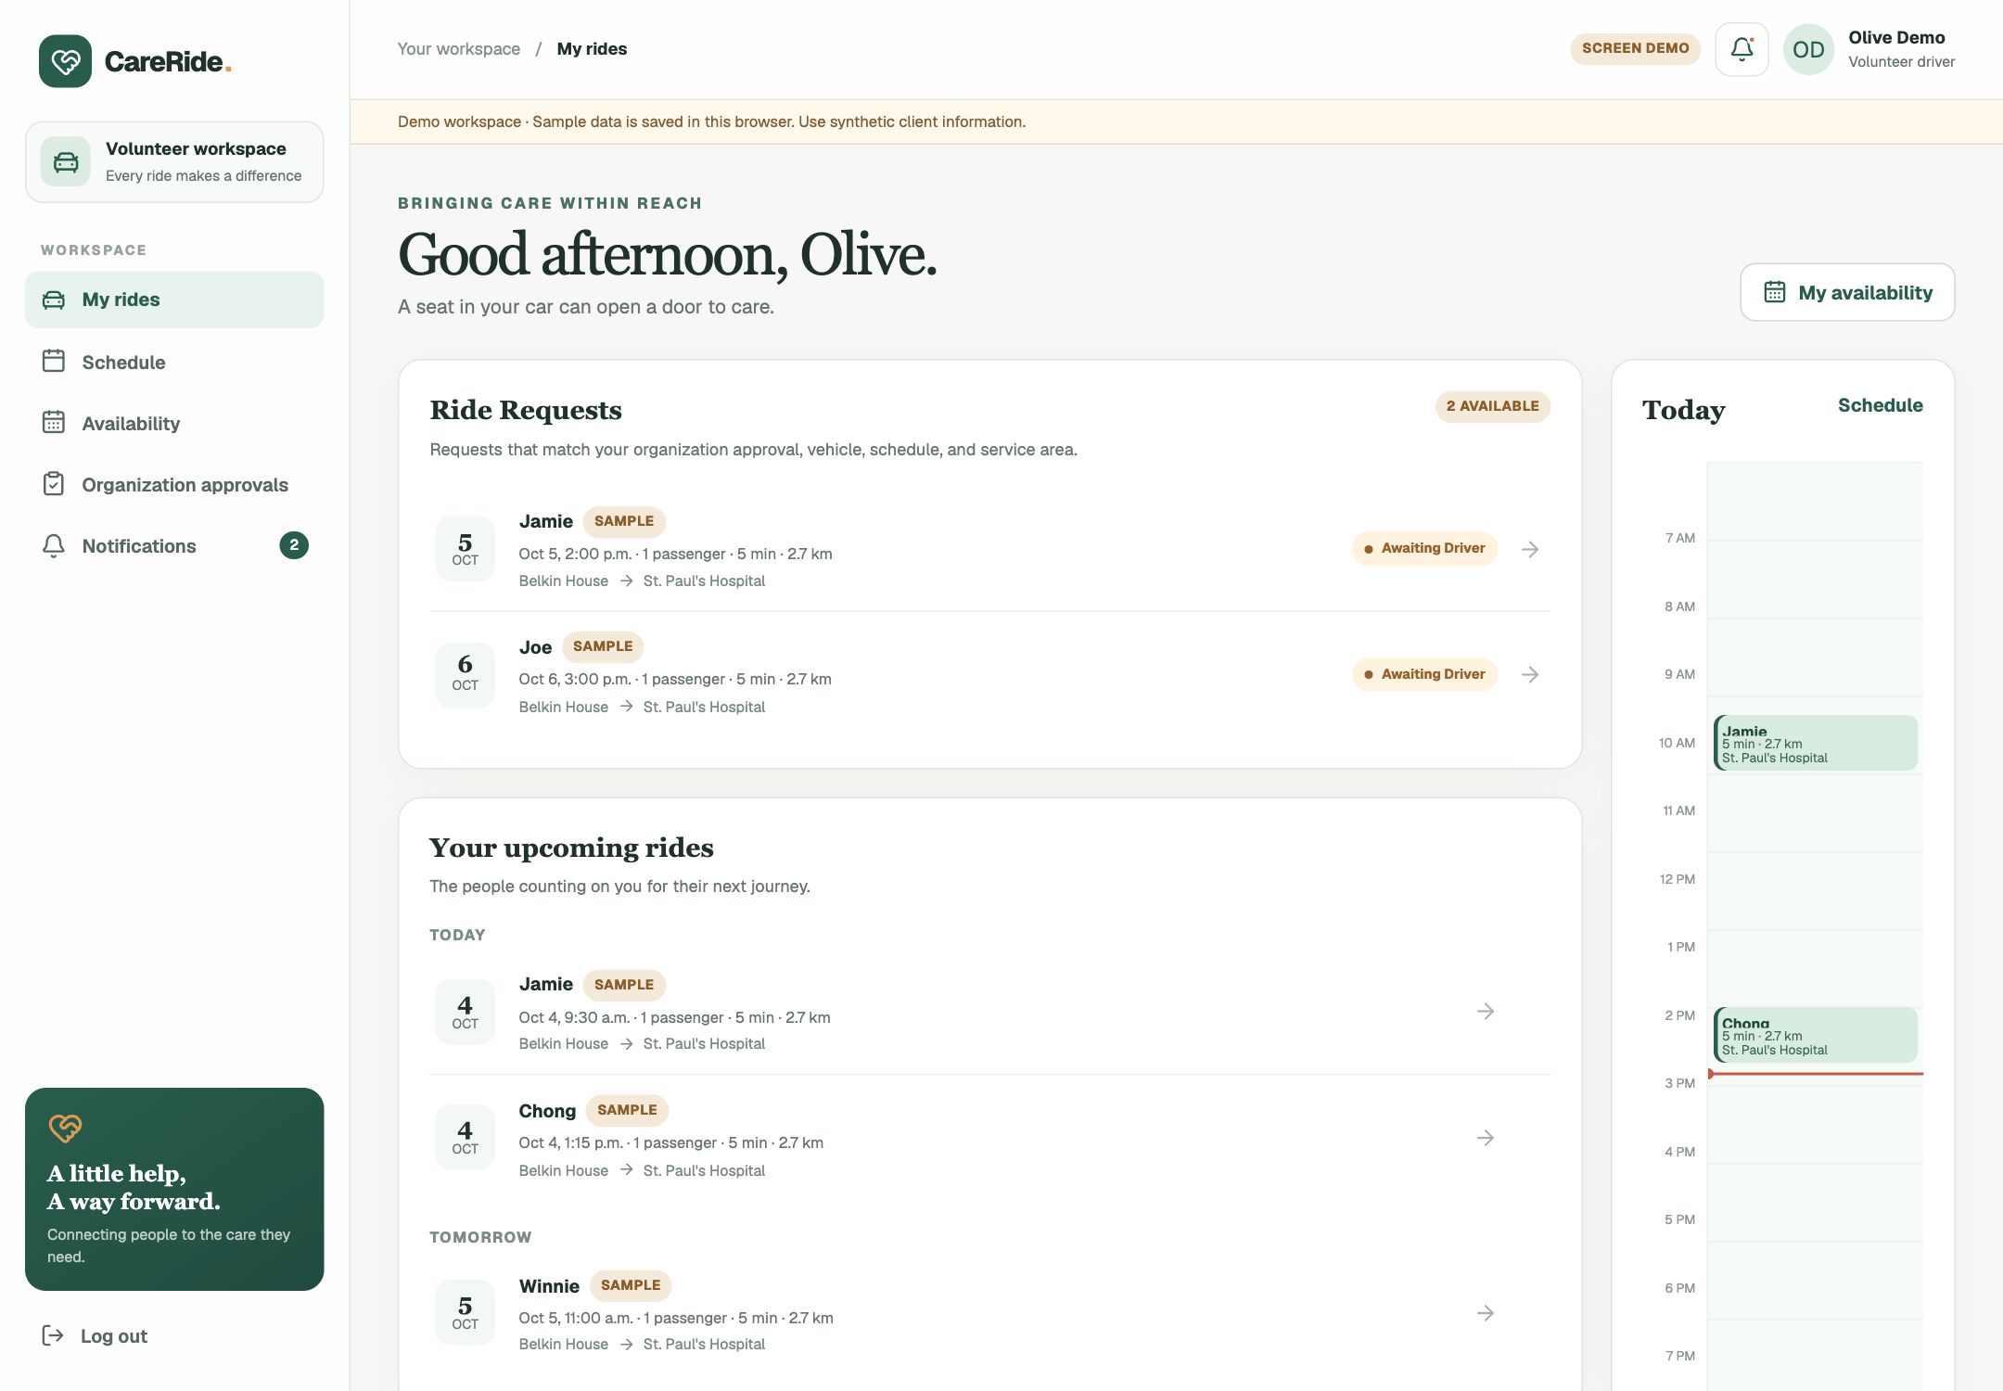
CareRide.
TEAM 2 · HACKVAN2026
THE DRIVER EXPERIENCE
A helping hand
behind the wheel.
Review eligible rides
Accept a request
Update pickup + drop-off
A little kindness travels a long way.
ACTUAL PROTOTYPE · SYNTHETIC DEMO DATA
06 / 10
Notes:
60 seconds.
On the other side is the volunteer driver. The driver view brings available rides and their own commitments together. The driver can review an eligible request, accept it, and update the journey at pickup and drop-off. Staff then have a shared record of what is happening. For a live demonstration, I would switch to a sample driver, open an available request, and show the acceptance and journey actions. Organization approval is part of the model: signing up alone does not make someone eligible for every organization’s rides. Driver availability and capacity help make the offer of a ride practical. The promise we want to test is simple: make it easier for a willing helping hand to become a useful journey.
Sources: CareRide Team 2 HACKVAN2026.pdf, pp. 19–21; docs/CARERIDE_REQUIREMENTS.md; current app source. Host: https://luma.com/faithtech-hack2026. Partnership and pilot are proposals. Screenshots contain synthetic demo data.

Slide 7
CareRide.
TEAM 2 · HACKVAN2026
DIGNITY AND ACCOUNTABILITY
Build trust
into the journey.
01
02
03
Accountable approval
Human support
Clear expectations
Each organization approves drivers for its rides.
Staff arrange rides and communications for clients.
Planned trips, visible status, and defined destinations.
Drivers approved by your organization.
07 / 10
Notes:
45 seconds.
For this audience, how we build matters as much as what we build. CareRide keeps the supporting organization involved. Each organization approves drivers for its rides, and staff remain the client’s point of contact in the first version. Trips are planned around essential services, with clear status and destination information. Emergency needs still go through emergency services. Before a live pilot, we need the partner to agree driver screening, insurance, consent, privacy, and escalation procedures. These are operational decisions to settle with the people responsible for care. The prototype gives us a foundation for that conversation; a responsible pilot will tell us what needs to change.
Sources: CareRide Team 2 HACKVAN2026.pdf, pp. 19–21; docs/CARERIDE_REQUIREMENTS.md; current app source. Host: https://luma.com/faithtech-hack2026. Partnership and pilot are proposals. Screenshots contain synthetic demo data.

Slide 8
CareRide.
TEAM 2 · HACKVAN2026
PROPOSED PILOT / SUBJECT TO PARTNER AGREEMENT
Start small.
Measure what matters.
01
02
03
Prepare
Run
Learn
One willing organization; named owner; approved drivers and routes.
A proposed four-week pilot with staff support and a fallback plan.
Measure completion, coordination time, and client/staff feedback.
Small steps. Stronger communities.
Proposed scope; no measured outcomes or confirmed pilot.
08 / 10
Notes:
45 seconds.
Our next step is a proposed four-week pilot with one willing organization, subject to its agreement. First, choose a named operational owner, a small set of destinations, and approved drivers. Agree the procedures and a fallback when no ride is available. Then run a limited set of planned trips. We should measure completed rides as a share of requests, time from request to acceptance, and staff time spent coordinating each ride. We also need direct feedback: did the client feel respected, and did staff find the process useful? The app’s sample savings are illustrative, not measured results. We want a baseline and real evidence before making claims about cost savings or improved access.
Sources: CareRide Team 2 HACKVAN2026.pdf, pp. 19–21; docs/CARERIDE_REQUIREMENTS.md; current app source. Host: https://luma.com/faithtech-hack2026. Partnership and pilot are proposals. Screenshots contain synthetic demo data.

Slide 9
CareRide.
TEAM 2 · HACKVAN2026
BUILT FOR FAITHTECH’S MISSION
Excellence. Impact. Hope.
01
02
03
Excellence
Impact
Hope
Clear, thoughtful tools for the people doing the work.
Reduce friction between a neighbour and essential care.
Turn a willingness to help into a practical next step.
Bring your community.
Host values: https://luma.com/faithtech-hack2026
09 / 10
Notes:
40 seconds.
FaithTech’s event names three values: Excellence, Impact, and Hope. CareRide gives us a practical way to pursue all three. Excellence means making a thoughtful tool that staff can understand and use. Impact means testing whether it actually helps neighbours reach care and reduces the work needed to coordinate that journey. Hope means acknowledging the barriers while taking a useful next step together. For a gathering building in the name of Jesus, we see this as a concrete expression of loving our neighbour: offering time, attention, and practical help. We want churches, service organizations, and volunteers to be able to bring their community into that work.
Sources: CareRide Team 2 HACKVAN2026.pdf, pp. 19–21; docs/CARERIDE_REQUIREMENTS.md; current app source. Host: https://luma.com/faithtech-hack2026. Partnership and pilot are proposals. Screenshots contain synthetic demo data.

Slide 10
CareRide.
TEAM 2 · HACKVAN2026
THE INVITATION
Help us make
a way forward.
01
02
03
Pilot with us
Drive with us
Build with us
A willing service organization and an operational lead.
Volunteers ready to follow agreed approval procedures.
FaithTech mentors and maintainers for the next phase.
A little help, A way forward.
Connecting people to the care they need.
10 / 10
Notes:
30 seconds.
Today, we are asking for three kinds of help: a willing organization to shape a pilot, volunteers to offer rides under agreed procedures, and FaithTech mentors and maintainers to help carry this beyond the weekend. The next step is a pilot planning conversation with the people who will run and use it. We believe a small act of coordination can open a meaningful path to care. CareRide: a little help, a way forward. Connecting people to the care they need.
Sources: CareRide Team 2 HACKVAN2026.pdf, pp. 19–21; docs/CARERIDE_REQUIREMENTS.md; current app source. Host: https://luma.com/faithtech-hack2026. Partnership and pilot are proposals. Screenshots contain synthetic demo data.

